Slide 1
SMAP Data Access and Analysis
15 November, 2022

Slide 2
Objectives
By the end of this exercise, you will be able to:
Access SMAP data
Visualize and analyze SMAP data

Slide 3
Outline
SMAP Data Products
SMAP Data Product Summary
Product Configuration
Discover, Download, and Visualize SMAP Data
Sites
Tools
Download SMAP Data
SMAP Data Analysis
Extracting SMAP Soil Moisture Values
Open the File

Slide 4
SMAP Data Products

Slide 5
SMAP Data Products
Data Product Short Name | Description | Grid Resolution | Granule Extent
L1A_Radar* | Parsed Radar Instrument Telemetry |  | Half Orbit
L1A_Radiometer | Parsed Radiometer Instrument Telemetry |  | Half Orbit
L1B_S0_LoRes* | Low resolution Radar σ₀ in Time Order | 5x30 km (10 slices) | Half Orbit
L1C_S0_HiRes* | High Resolution Radar σ₀ on Swath Grid | 1 km | Half Orbit
L1B_TB | Radiometer T_{B} in Time Order | 39 x 47 km | Half Orbit
L1C_TB | Radiometer T_{B} | 36 km | Half Orbit
L2_SM_A* | Radar Soil Moisture (includes Freeze-Thaw) | 3 km | Half Orbit
L2_SM_P | Radiometer Soil Moisture | 36 km | Half Orbit
L2_SM_AP* | Active-Passive Soil Moisture | 9 km | Half Orbit
L3_FT_A* | Daily Global Composite Freeze/Thaw State | 3 km | North of 45° N
L3_SM_A* | Daily Global Composite Radar Soil Moisture | 3 km | Global
L3_SM_P | Daily Global Composite Radiometer Soil Moisture | 36 km | Global
L3_SM_AP* | Daily Global Composite Active-Passive Soil Moisture | 9 km | Global
L4_SM | Surface & Root Zone Soil Moisture | 9 km | Global
L4_C | Carbon Net Ecosystem Exchange | 9 km | North of 45° N
*Only available during the 2.5 months of radar operation (mid-April – July 7, 2015)

Slide 6
SMAP Data Product Summary
Updated SMAP Data Products
Data Product | Description | Grid Resolution | Algorithm Source
L1A_Radiometer | Radiometer Data in Time-Order | - | Mission DA
L1B_TB | Radiometer T_{B} in Time Order | 39 x 47 km | Mission DA
L1C_TB | Radiometer T_{B} in Half-Orbits | 36 km | Mission DA
L1C_TB_E | Radiometer T_{B} in Half-Orbits, Enhanced | 9 km | Mission DA
L2_SM_P | Soil Moisture (Radiometer) | 36 km | Mission DA
L2_SM_P_E | Soil Moisture (Radiometer) | 9 km | Mission DA
L2_SM_SP | Soil Moisture (Sentinel Radar + Radiometer) | 3 km | Mission DA
L3_FT_P | Soil Moisture (Radiometer) | 36 km | Mission DA
L3_SM_P_E | Soil Moisture (Radiometer, Enhanced) | 3 km | Mission DA
L3_SM_P | Soil Moisture (Radiometer) | 36 km | Mission DA
L3_SM_P_E | Soil Moisture (Radiometer, Enhanced) | 9 km | Mission DA
L4_SM | Soil Moisture (Surface & Root Zone) | 9 km | Mission DA
L4_C | Carbon Net Ecosystem Exchange (NEE) | 9 km | Mission DA

Slide 7
SMAP Product Configuration
All products are in HDF5 format
Each SMAP HDF5 file contains the primary data parameters (e.g., soil moisture, freeze/thaw, sensor data) and all data used in the production of those parameters
Files also include metadata, geolocation information, quality flags, etc.
Projection: EASE-Grid 2.0
Equal-area projection
Level 2, 3, 4, and radiometer L1C are in this projection
Values
Radiometer data (brightness temperature) is in Kelvin
Radar data is in sigma naught
Soil moisture is a volumetric measurement expressed as cm3/cm3
Freeze/thaw is a binary measurement, either frozen or thawed
Net ecosystem exchange is in grams of carbon/square meter per day

Slide 8
Discover, Download, and Visualize SMAP Data

Slide 9
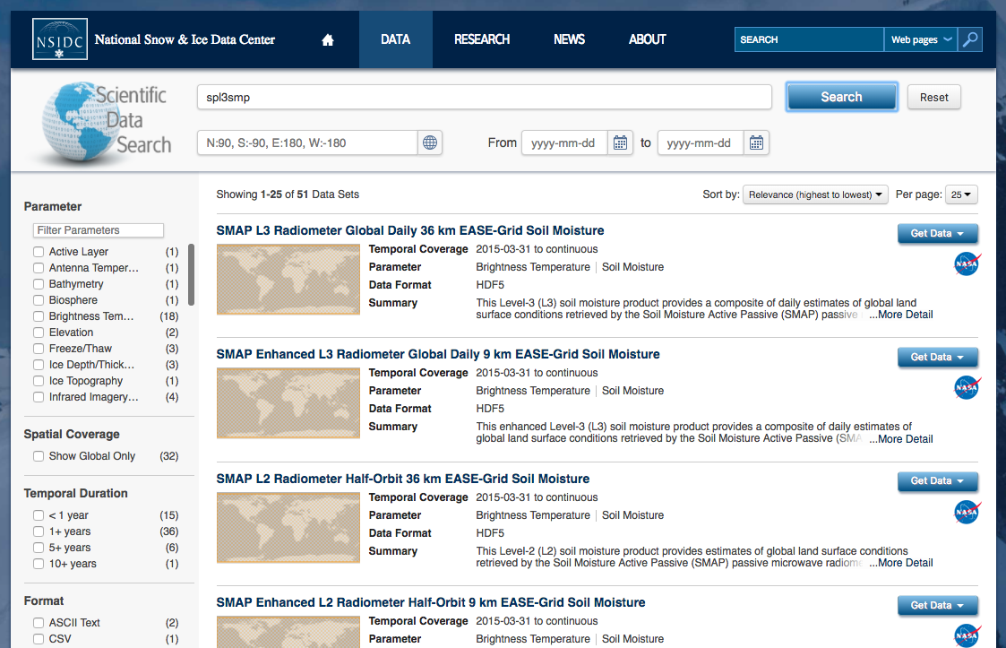
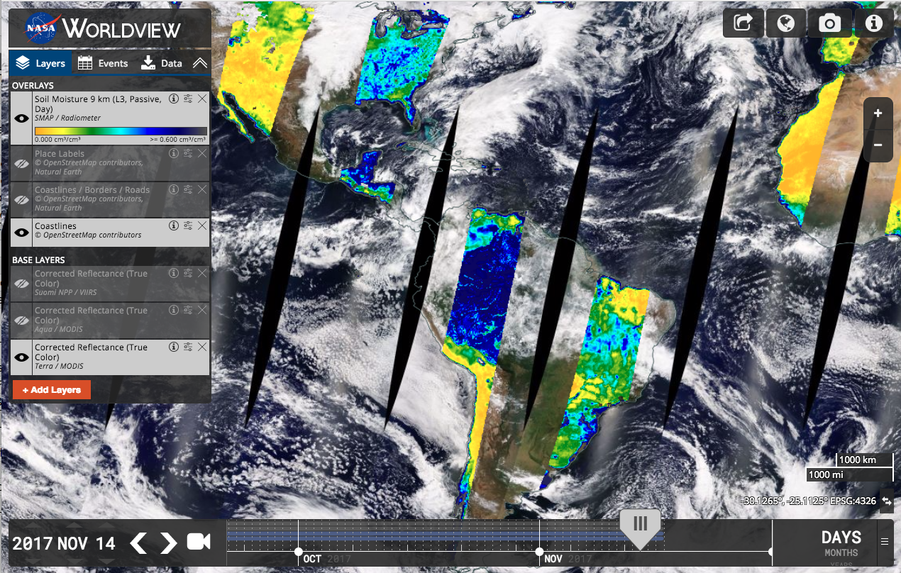
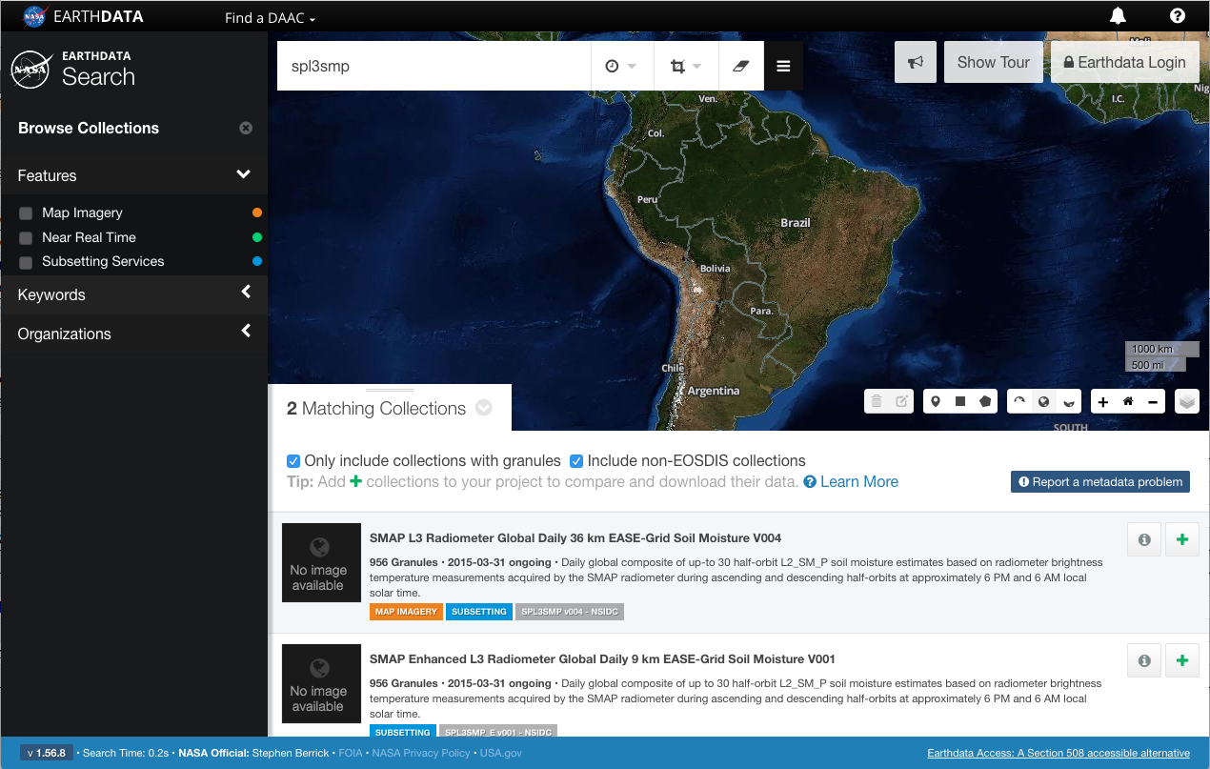
Sites to Discover, Download, and Visualize SMAP Data
NSIDC: Data Search, Documentation, & Access
http://nsidc.org/data/ search/
Worldview: Data Visualization and Download
http://worldview. earthdata.nasa.gov/
Earthdata: Data Access & Output Customization
http://search.earthdata.nasa.gov/

Slide 10
National Snow & Ice Data Center (NSIDC)
http://nsidc.org/data/smap/
Provides access to L1 radiometer data and all L2, L3, and L4 radiometer products
Provides data access, dataset user guide documents, tools, news, published research, quality information, FAQs, and many other resources
Direct access to SMAP data (with logins) through:
HTTPS: https://n5eil01u.ecs.nsidc.org/SMAP/
Subscribe here: http://nsidc.org/daac/subscriptions.html for an automatic delivery of data as it becomes available

Slide 11
Worldview
http://worldview.earthdata.nasa.gov
Data visualization and download
Imagery is generally available within several hours
Image output in JPEG, PNG, GeoTIFF, and KML
Earthdata Search
http://search.earthdata.nasa.gov/
Allows you to search, order, and visualize all SMAP data
You can perform a keyword, spatial, or temporal search
Reformats, reprojects, and subsets services for most products

Slide 12
Tools
The HDF5 Group Support: http://support.hdfgroup.org/products/hdf5_tools/
Allows you to access and visualize SMAP HDF5 data using Python, NCL, MATLAB®, and IDL®
Access HDF5 tools:
http://support.hdfgroup.org/products/hdf5_tools/index.html
Download code in Python, NCL, MATLAB®, and IDL®:
http://hdfeos.org/zoo/index_openNSIDC_Examples.php#SMAP

Slide 13
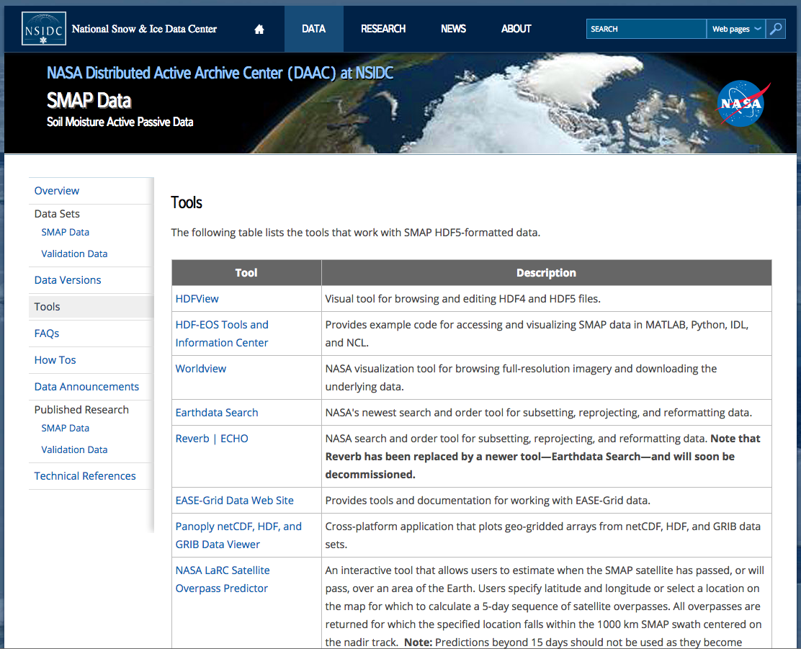
Tools That Work with SMAP HDF5-Formatted Data
http://nsidc.org/data/smap/tools
The native format of SMAP Data files is HDF5. NSIDC offers a tools page with a couple of tools for easy viewing of the HDF5 files: Panoply and HDFView
http://support.hdfgroup.org/products/hdf5_tools/index.html
download code in Python, NCL, MATLAB®, and IDL®:
http://hdfeos.org/zoo/index_openNSIDC_Examples.php#SMAP

Slide 14
Tools That Work with SMAP HDF5-Formatted Data
http://nsidc.org/data/smap/tools
For the SPL3SMP collection, Earthdata Search service options allow for the reformatting of the native HDF5 files to:
GeoTIFF, ASCII, NetCDF-3, NetCDF4-CF, KML, and HDF-EOS5
For a detailed table of what subsetting, reformatting, and reprojection services are available for SMAP collections, please see:
https://support.nsidc.org/entries/97456598-What-data-subsetting-reformatting-and-reprojection-services-are-available-for-SMAP-data-

Slide 15
Download SMAP Data

Slide 16
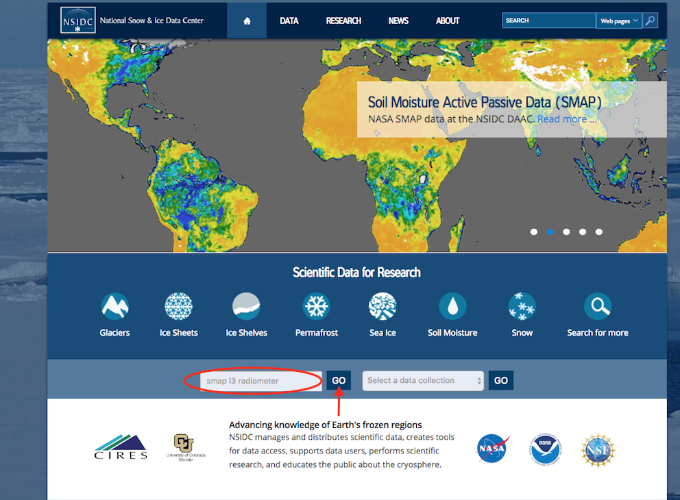
Discovering SMAP Data at NSIDC
http://nsidc.org/
NASA National Snow & Ice Data Center (NSIDC) is a Distributed Active Archive Center (DAAC)
1 of 12 NASA Earth Observing System Data and Information System (EOSDIS) DAACs
Distributes nearly 500 NASA data sets
primarily focused on the cryosphere
Notes:
The NASA National Snow and Ice Data Center (NSIDC) Distributed Active Archive Center (DAAC) is one of twelve NASA Earth Observing System Data and Information System (EOSDIS) DAACs that manage, archive and distribute Earth Science data as part of NASA's Earth Science Data Systems Program.
We distribute nearly 500 NASA data sets, primarily focused on the cryosphere. After introducing you to NASA’s Worldview and Earthdata Search, I’ll take you on a tour of NSIDC’s Scientific Data Search where I’ll demonstrate how to access and find detailed information about SMAP data.

Slide 17
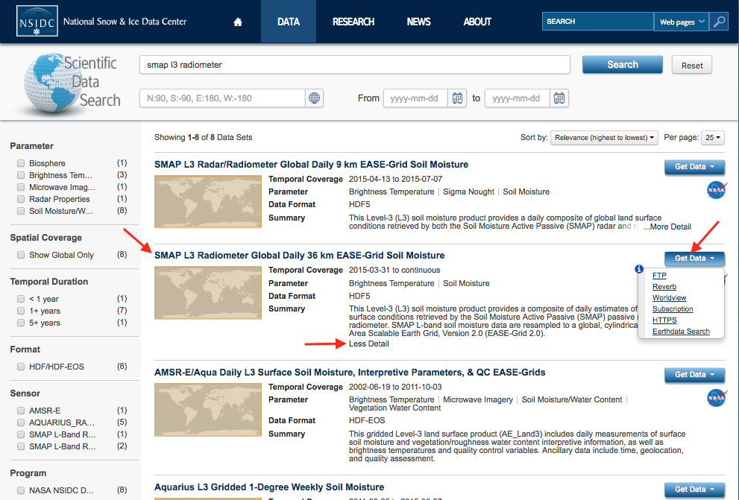
Discovering SMAP Data at NSIDC
http://nsidc.org
Clicking on the data set name in the Search results will take you to the collection’s catalog page

Slide 18
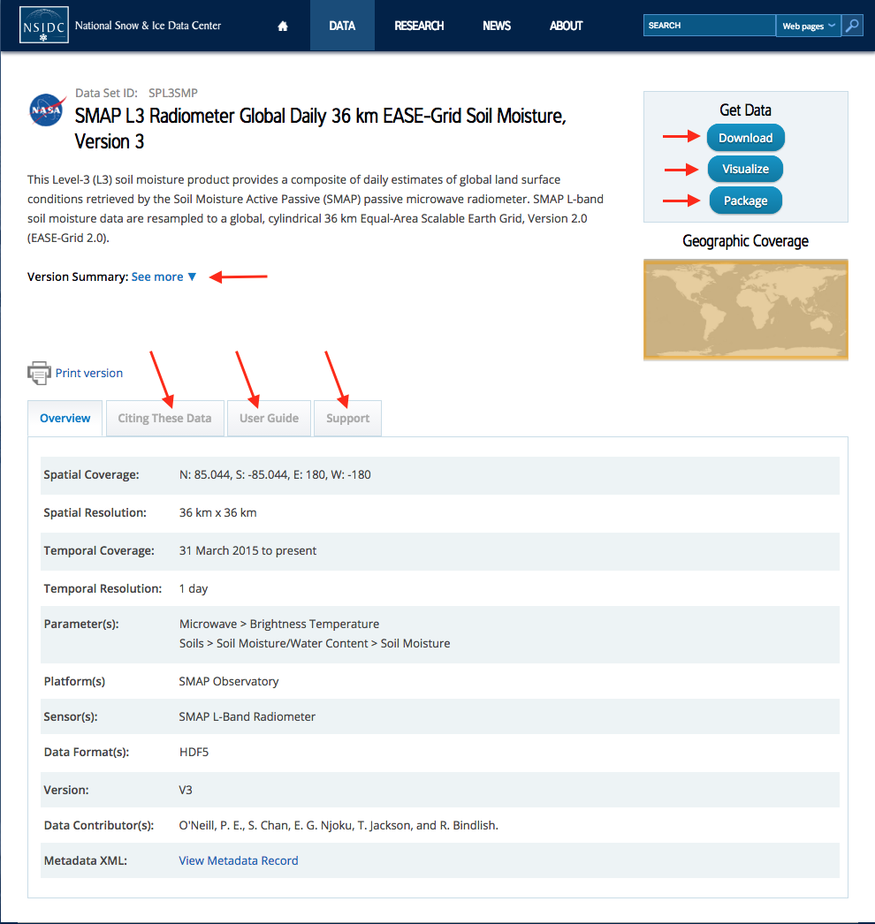
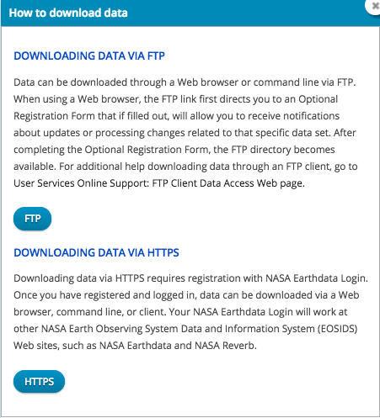
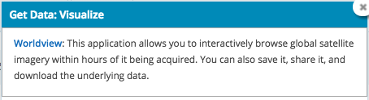
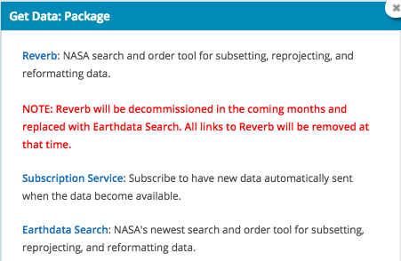
Discovering SMAP Data at NSIDC
http://nsidc.org/
From the catalog page, you can use the Get Data options to explore options to download, visualize, and customize your data order
You’ll also notice there’s an overview of the data in the collection. Clicking on the different tabs will highlight how to cite this data, provide you with a user guide, and how to reach NSIDC for support

Slide 19
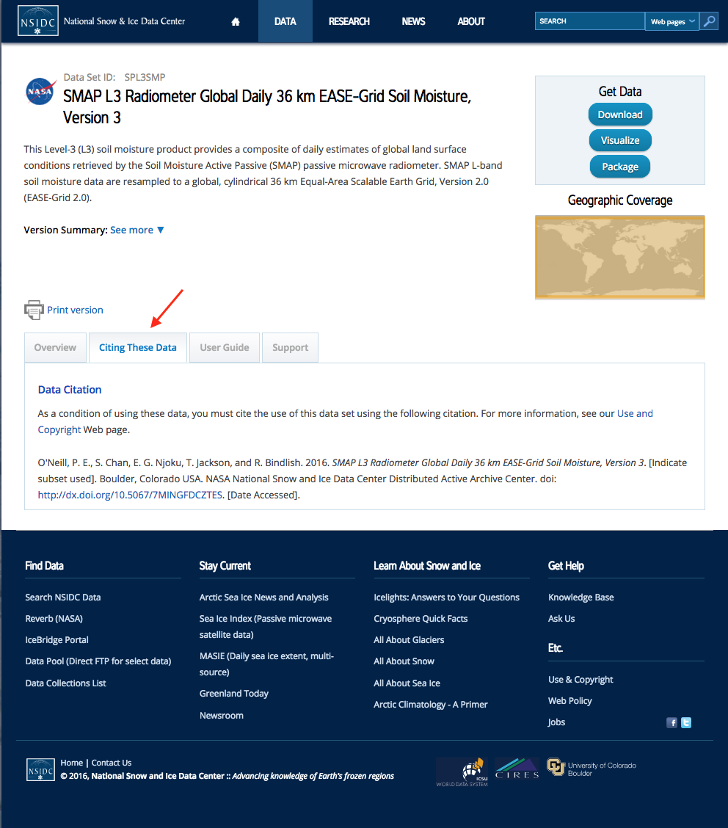
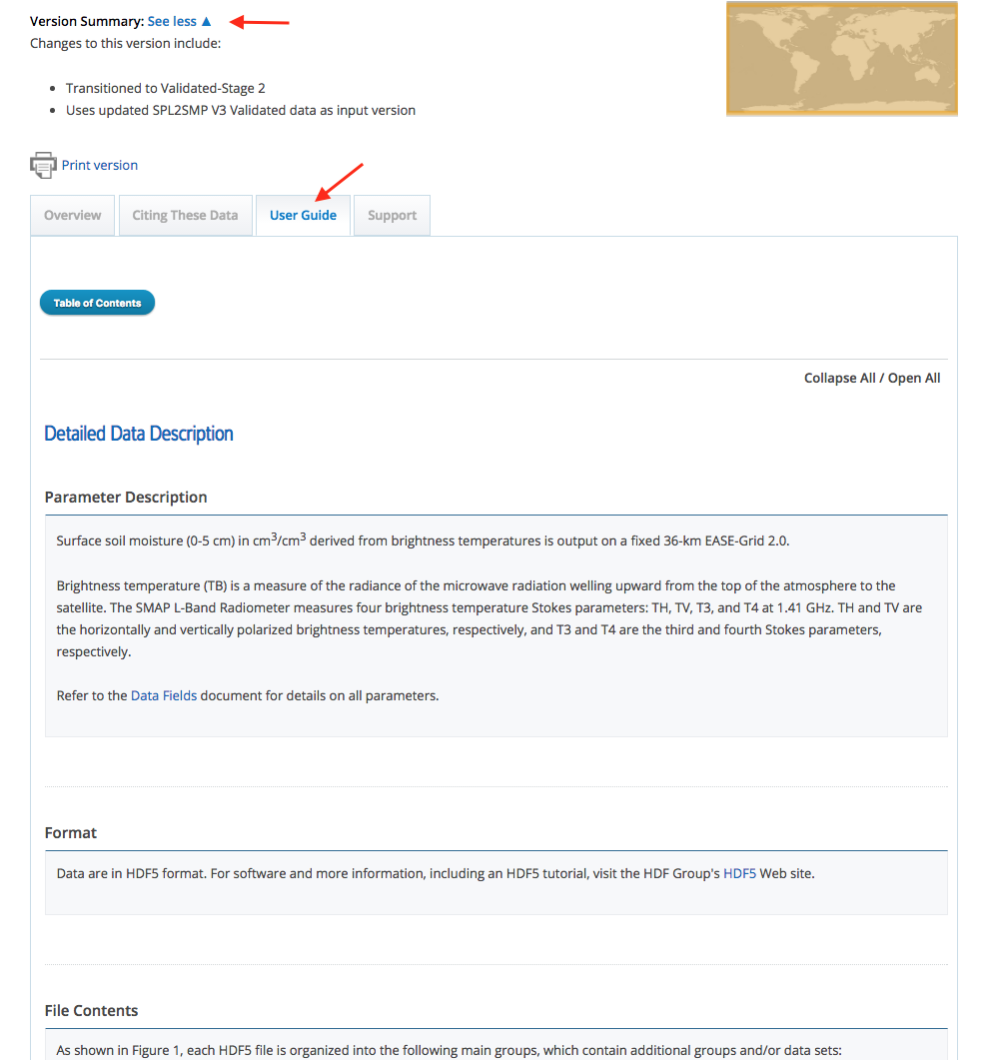
Discovering SMAP Data at NSIDC
http://nsidc.org/

Slide 20
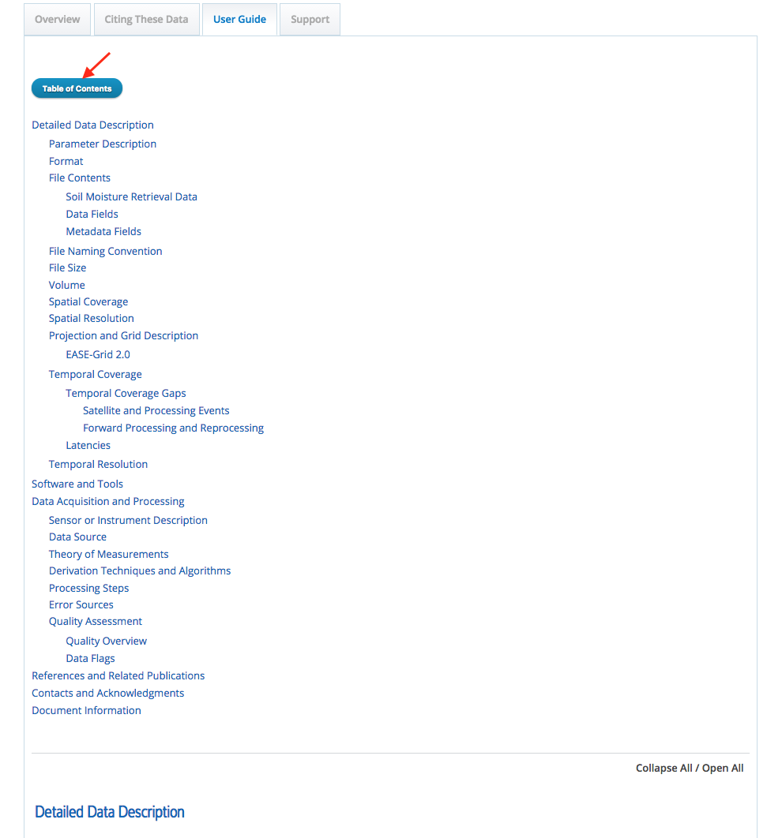
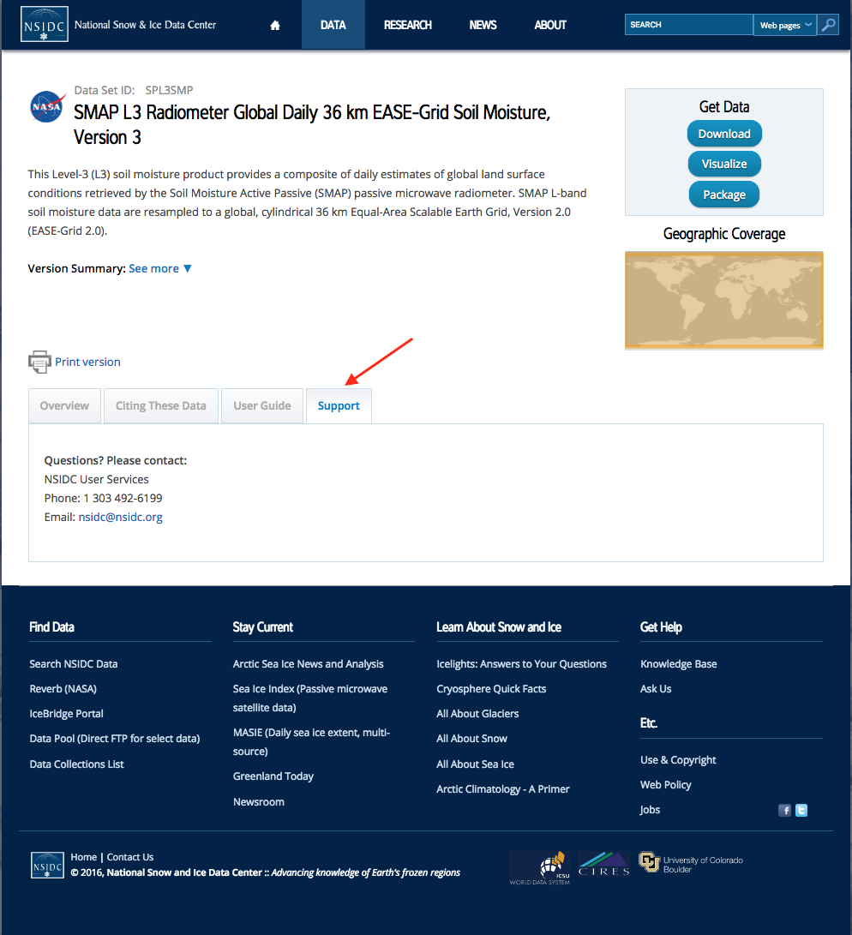
Discovering SMAP Data at NSIDC
http://nsidc.org

Slide 21
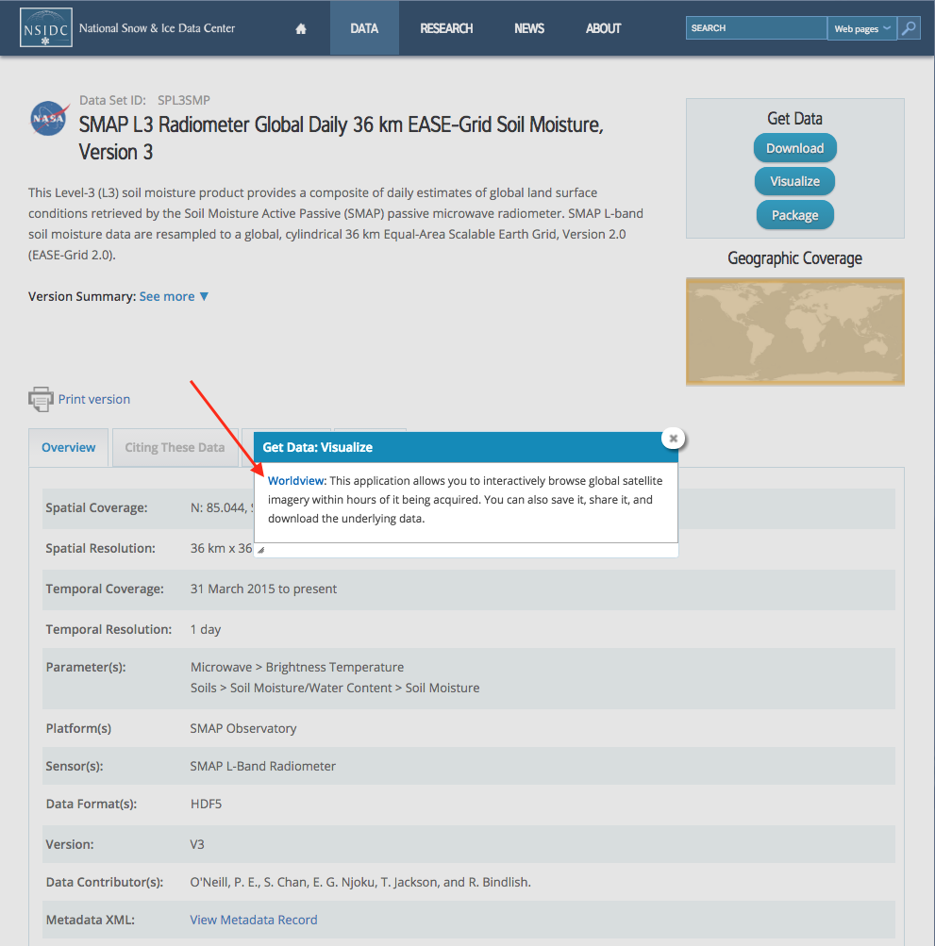
Discovering SMAP Data at NSIDC
http://nsidc.org
Revisiting the Visualize button under Get Data, let’s click Worldview and explore what this application has to offer

Slide 22
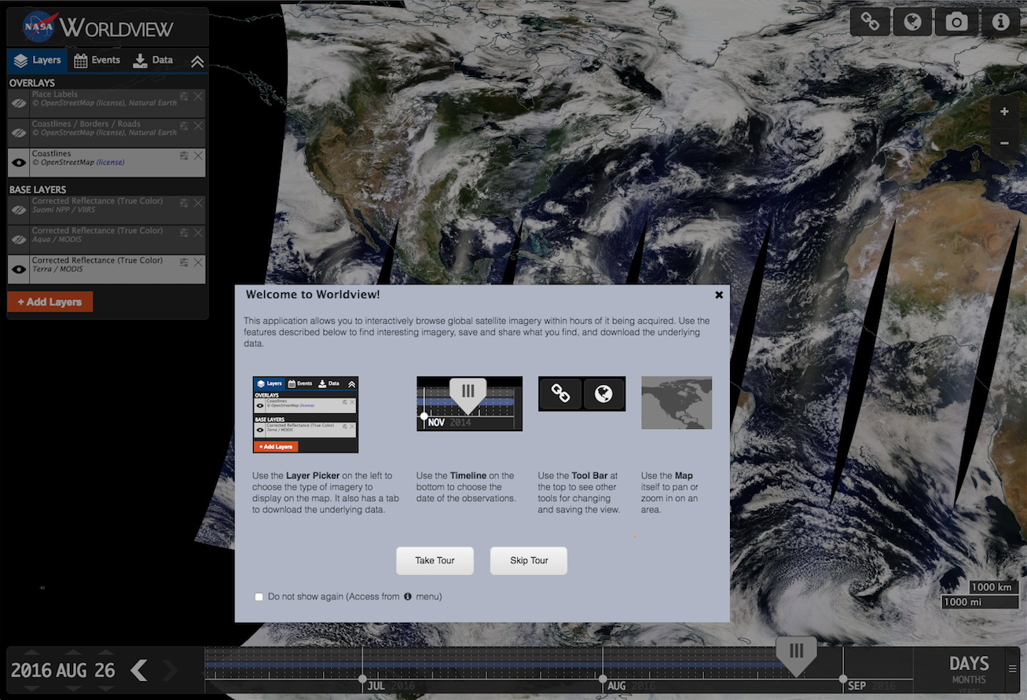
Exploring SMAP Data in NASA’s Worldview
http://worldview.earthdata.nasa.gov/
Worldview provides you with the ability to interactively browse global, full-resolution satellite imagery and download the underlying data & image files
Uses Global Imagery Browse Services (GIBS)
Most of the 100+ available products are updated within 3 hrs of observation
Notes:
NASA’s Worldview provides you with the ability to interactively browse global, full-resolution satellite imagery and download the underlying data and image files.
It uses the Global Imagery Browse Services (GIBS) to rapidly retrieve imagery for this interactive browsing experience.
Most of the 100+ available products are updated within three hours of observation, essentially showing the entire Earth as it looks "right now".
Following my demonstration of SMAP data discovery and access at NSIDC, I’ll take you through a tour of Worldview.

Slide 23
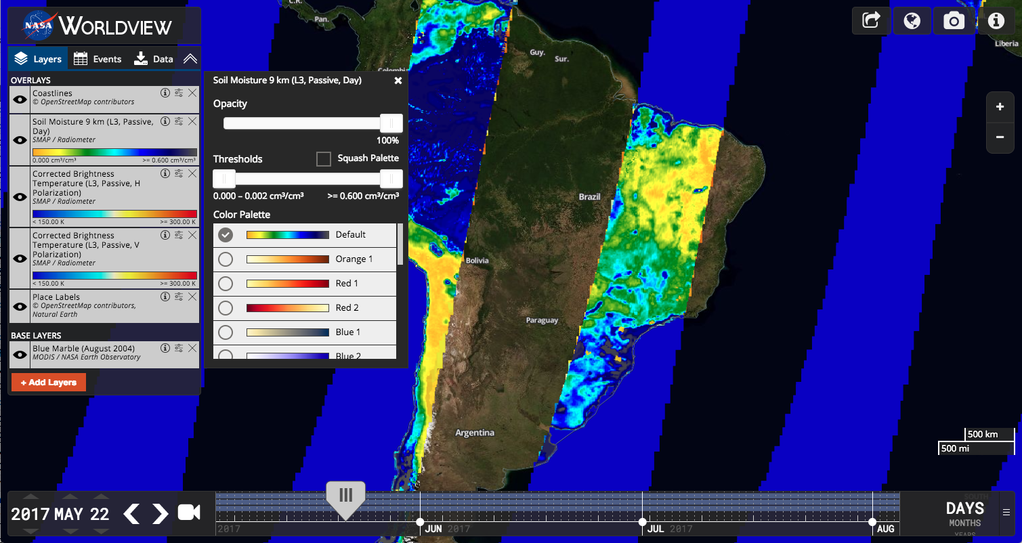
Visualizing and accessing SMAP Data from Worldview
Here, I’ve repositioned the Coastlines layer above Soil Moisture – notice the outlines visible in the Arctic over the Soil Moisture data
Also, clicking on the slider-bar symbol will open a dialogue to allow for changing the layer’s opacity, thresholds and color palette
Clicking the “X” symbol for a layer removes it from the Layers panel
Exposes the panel to alter the layer’s look
Removes this layer from the Layers Panel
Notes:
In this slide, I’ve repositioned the Coastlines layer above Soil Moisture – notice the outlines visible in the Arctic over the Soil Moisture data.
Also, clicking on the slider-bar symbol will open a dialogue to allow for changing the layer’s opacity, thresholds and color palette.
Clicking the “X” symbol for a layer removes it from the Layers panel.

Slide 24
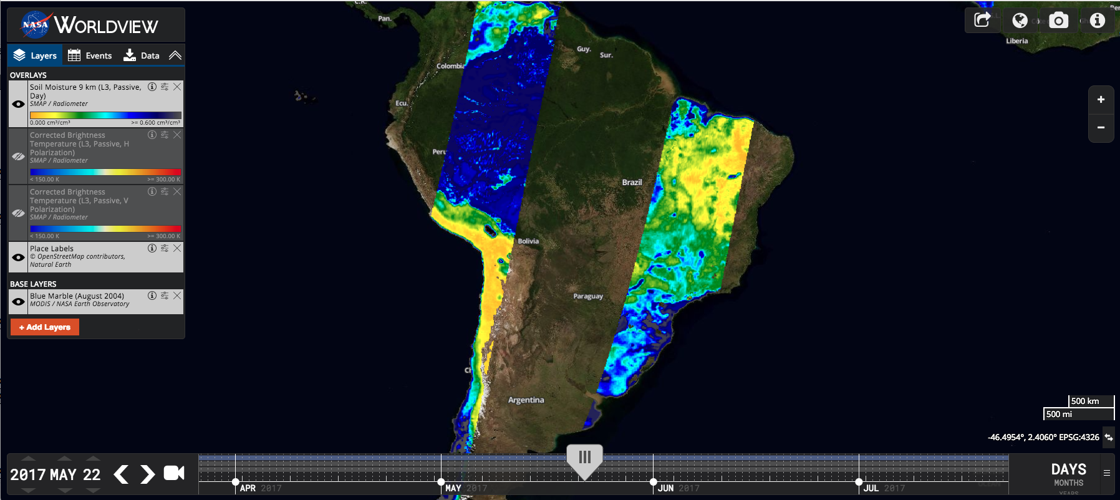
Exploring the Worldview Interface Further
Tabs for displaying current layers, current world events, or downloading underlying data
Collapse the layer pane
Turn overlay on or off
Click to browse through other layers to add

Slide 25
Exploring the Worldview Interface Further
Copy a URL of this map to share
Change the projection of the display
Take a snapshot of the interface
Information about Worldview
Zoom in or out – can also use your mouse’s scroll wheel, double click on the map, or shift-drag to zoom to an area

Slide 26
Exploring the Worldview Interface Further
The blue line indicates the layer is on and available during this time range
Slider control to change the date of the layer displayed
Change the month, day, and year of the data displayed
Collapse the timeline
Gray lines indicate layers are off, but available during this time range
Change the timeline’s finest increment shown
Advanced forward or back a day at a time

Slide 27
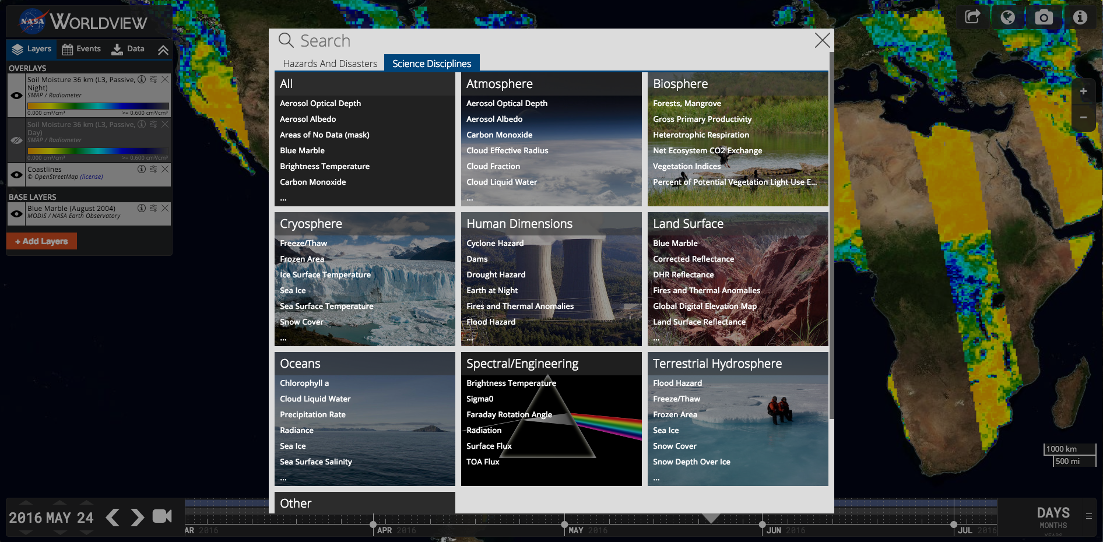
Exploring Layer Options
Clicking the add layers button opens this dialogue where you can search by topic on the “Hazards and Disasters” tab or under the “Science Disciplines” tab where we are now. SMAP can be found under the Terrestrial Hydrosphere category.
You may also search by keyword at the top of this dialogue by click on the “Search” text
Click and type here for a keyword search
Click this category to expand and reveal SMAP data
Notes:
30

Slide 28
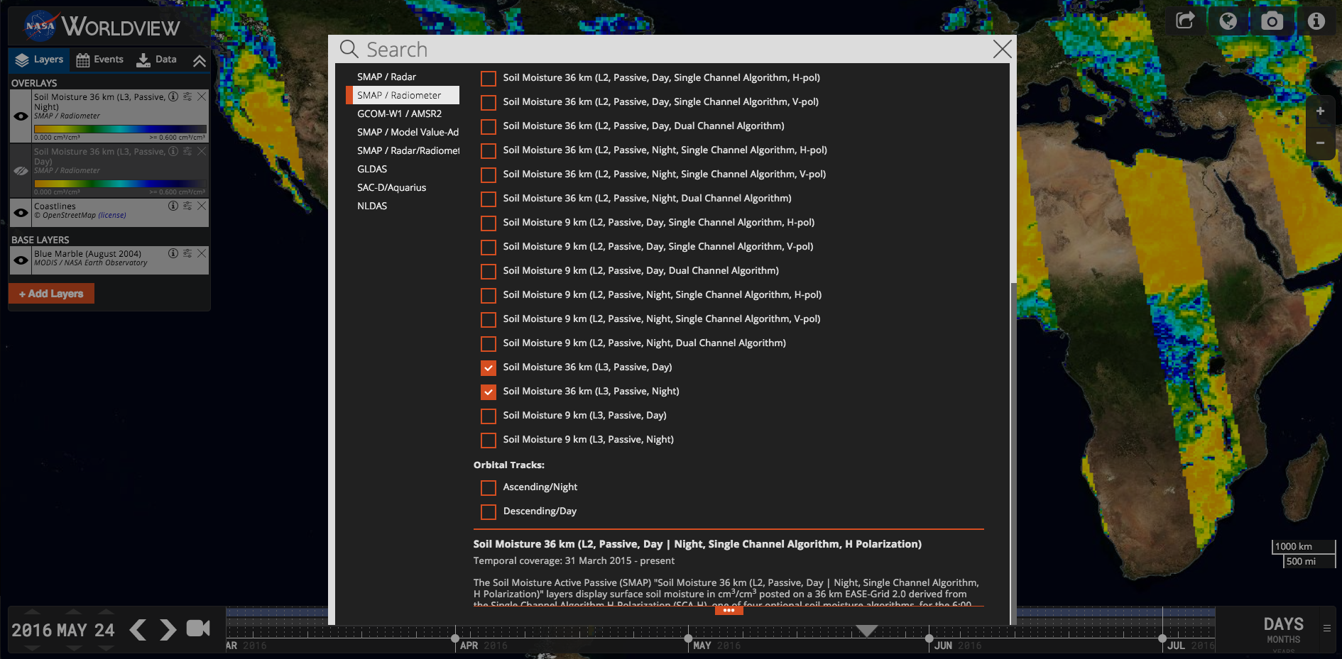
SMAP Layer options:
Click to reveal more details about the SMAP radiometer collections

Slide 29
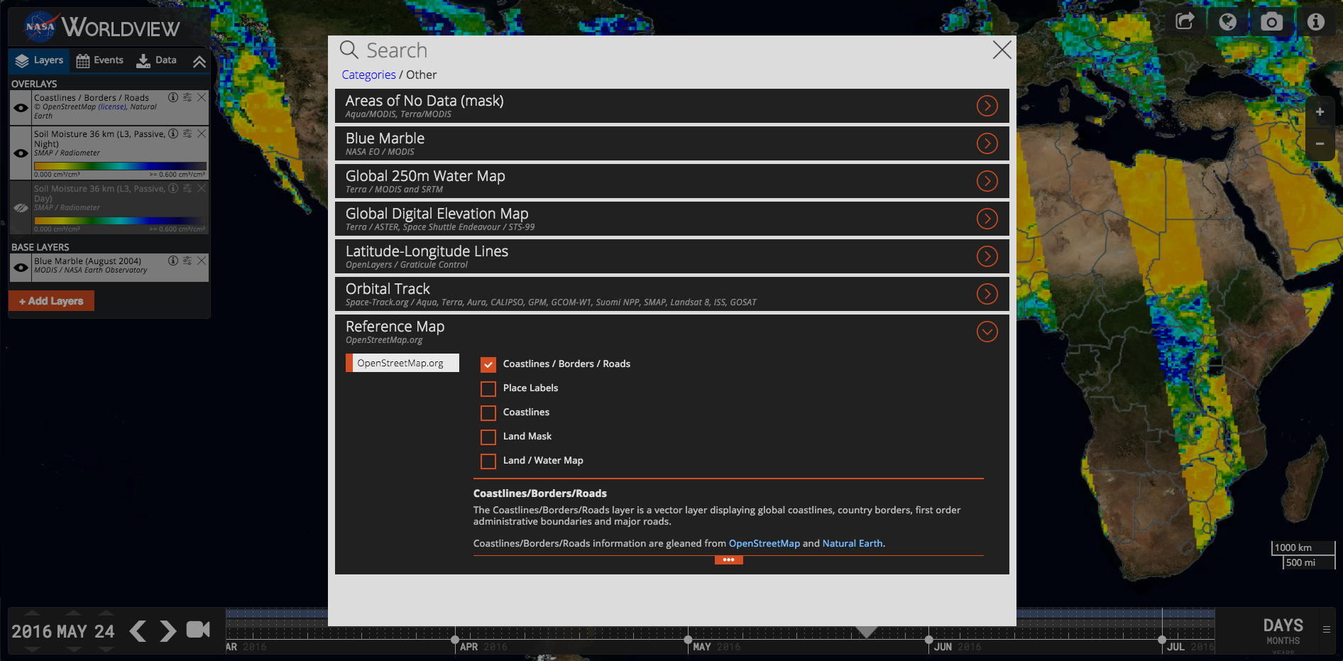
Adding an Overlay: Coastlines / Borders / Roads
I’ve clicked on the “Other” category from the “Science Disciplines” tab and changed the default “Coastlines” layer to be “Coastlines/Borders/Roads” to add more detail to the map

Slide 30
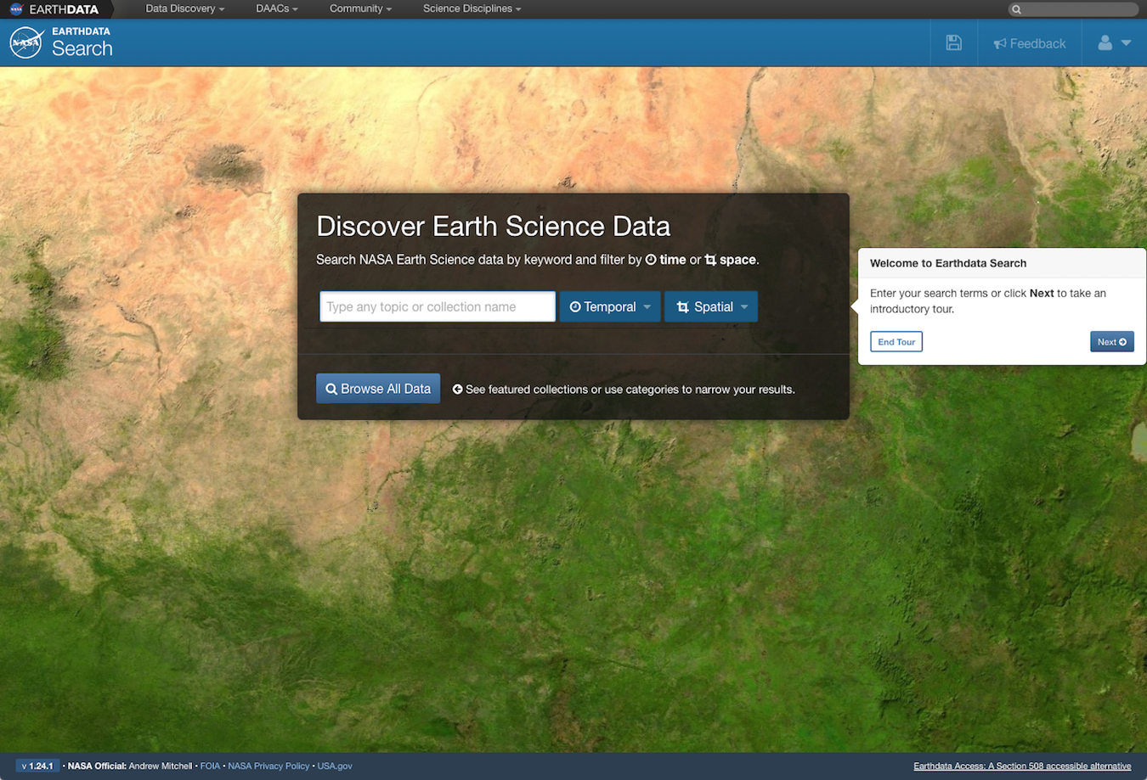
Accessing SMAP Data with NASA’s Earthdata Search
http://search.earthdata.nasa.gov/search
Connects users to their data by making data search, discovery, and access available in one application
Offers the ability to search across disciplines and DAACs
For the last live demonstration, I’ll go through
the interface’s filtering options to hone a search for SMAP L3 Radiometer Global Daily 36 km EASE-Grid Soil Moisture (SPL3SMP)
available ordering and subsetting options
Notes:
NASA's Earthdata Search application connects users to their data by making data search, discovery, and access available in one application.
Earthdata Search offers users the ability to search across disciplines and across DAACs. It goes beyond offering the ordering and downloading of data by providing subsetting services as well.
For my last live demonstration of the day, I’ll go through the interface’s filtering options to hone a search for SMAP L3 Radiometer Global Daily 36 km EASE-Grid Soil Moisture (SPL3SMP), followed by a look at the ordering and subsetting options available.

Slide 31
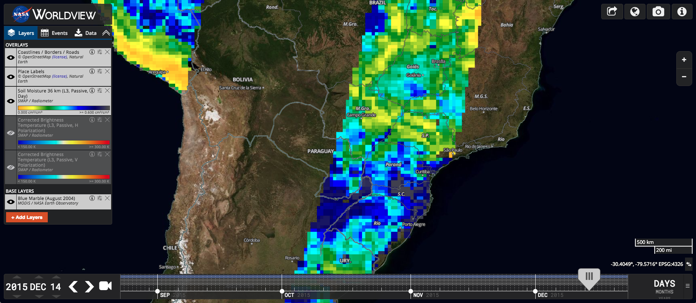
A Quick Comparison of Soil Moisture Across Time…
Paraná is about centered in the map. To compare soil moisture levels, we’ll look at a day in the wettest (December) and driest (August) months on average

Slide 32
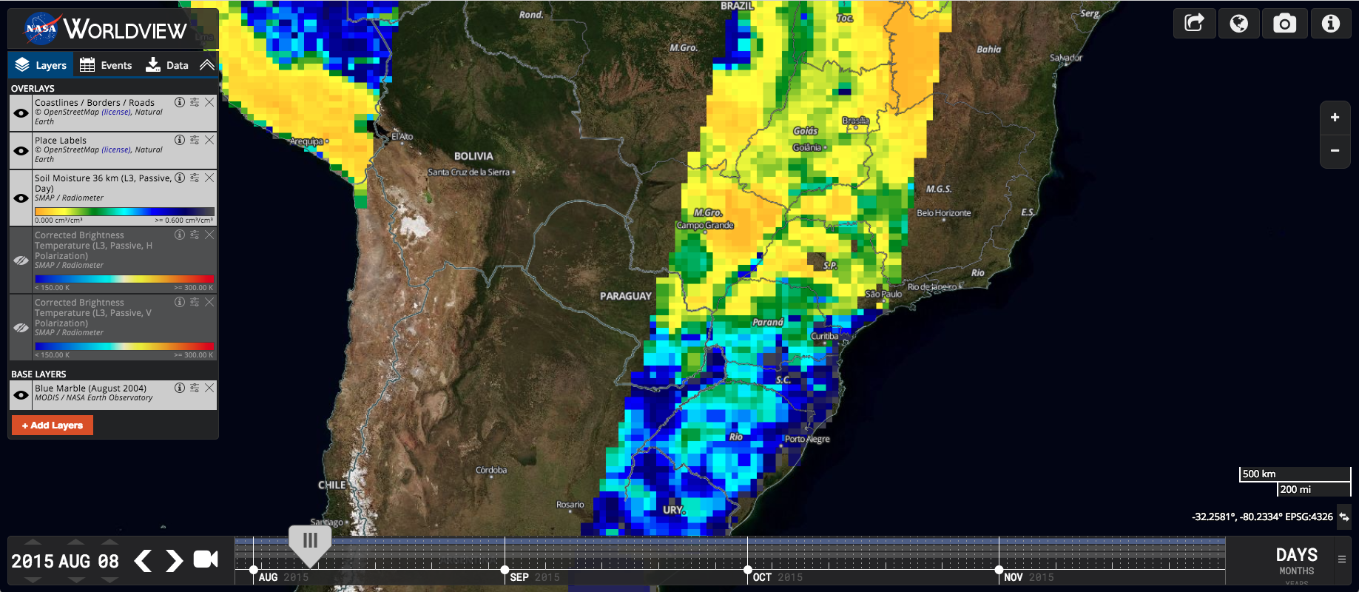
A Quick Comparison of Soil Moisture Across Time…
8 August 2015 has a similar swath as 14 Dec 2015 (previous slide)

Slide 33
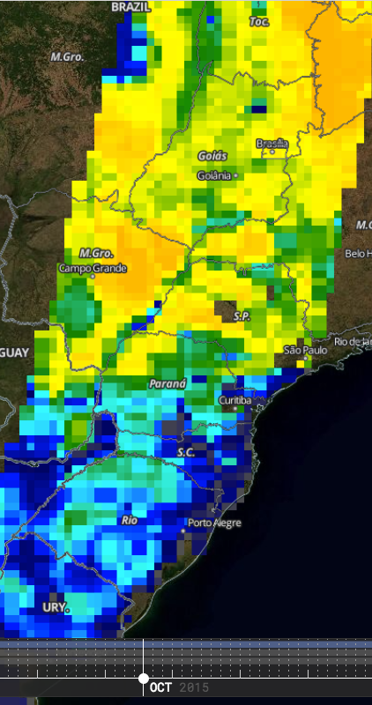
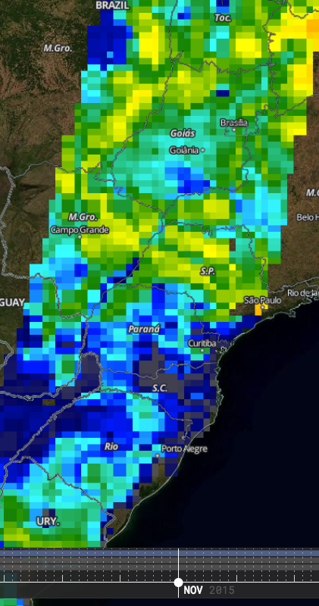
A Quick Comparison of Soil Moisture Across Time…
You can use the Share this Map option to copy links for the two days that you would like to compare and view them in browser windows placed side by side for a quick visualization of the soil moisture differences between the two dates
Overall, drier
Wetter

Slide 34
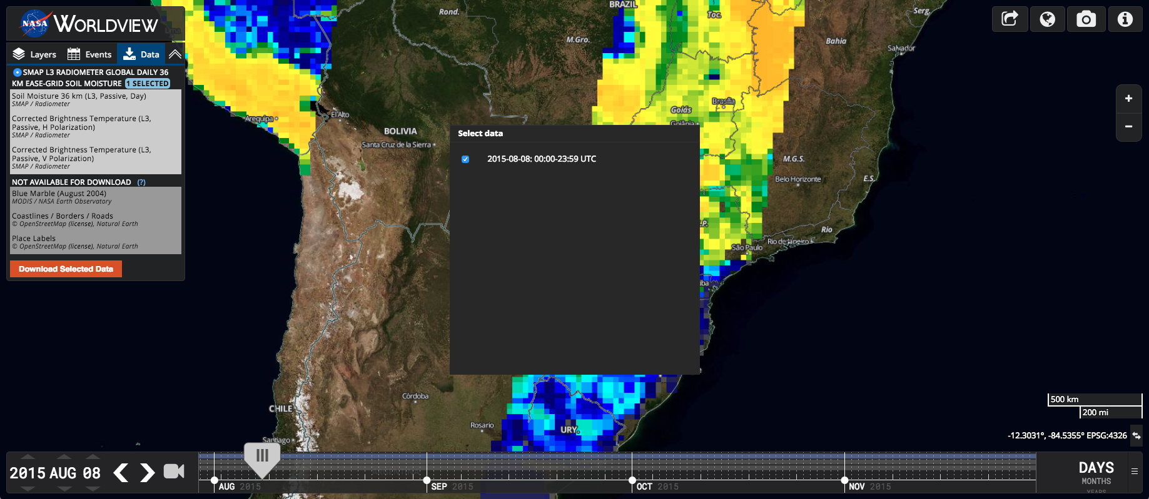
Downloading from Worldview:
Switch to the Data tab
Tick this box to select this day’s data

Slide 35
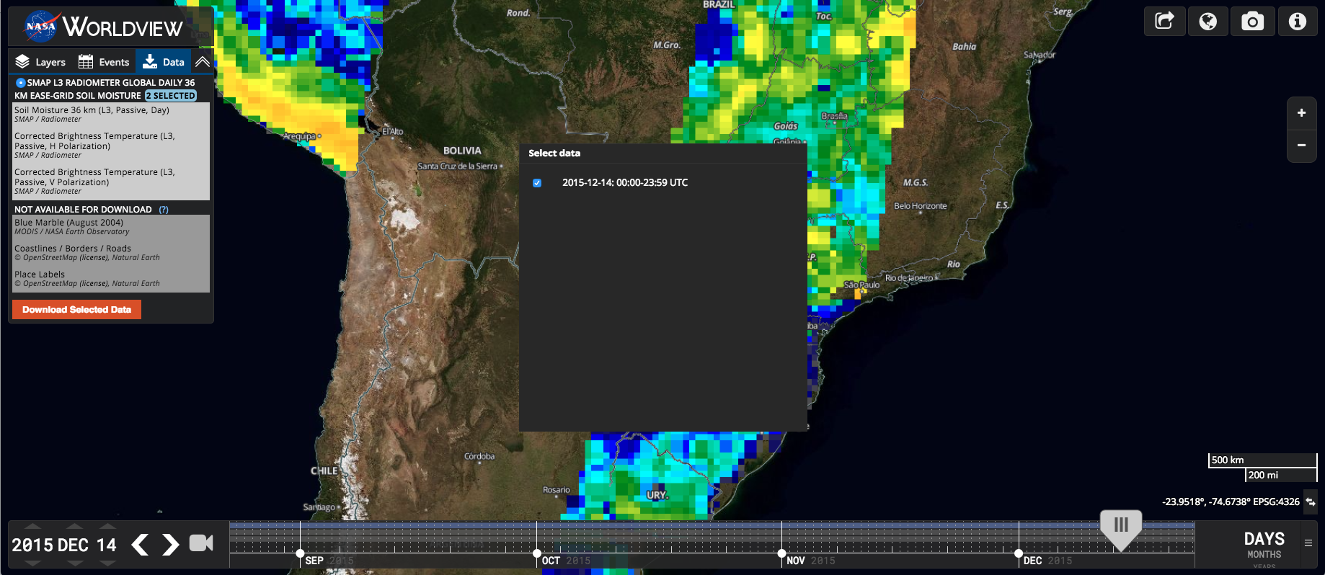
Downloading from Worldview:
Advance to the next day of Soil Moisture data and tick the box – notice that the data panel indicates “2 SELECTED”

Slide 36
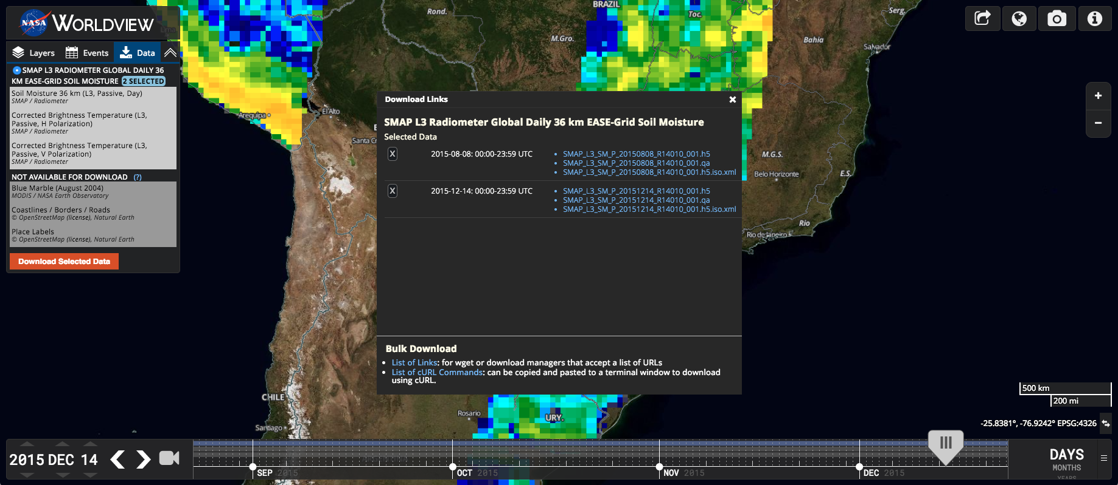
Downloading from Worldview:
Clicking on individual file names (in blue) in the top part of the box will download just that file to your machine. Depending on your browser, you may need to hover and right click on the .qa and .xml files and choose the Save link as option to save them to your machine rather than have them just open in a separate window or tab.
Clicking on the bottom of the box on either List of Links or List of cURL Commands will open a new tab or window in your browser with instructions on how to use these options (see next slide)
Click the “Download Selected Data” button and this dialogue pops up. You can remove files from your order and explore your download options.

Slide 37
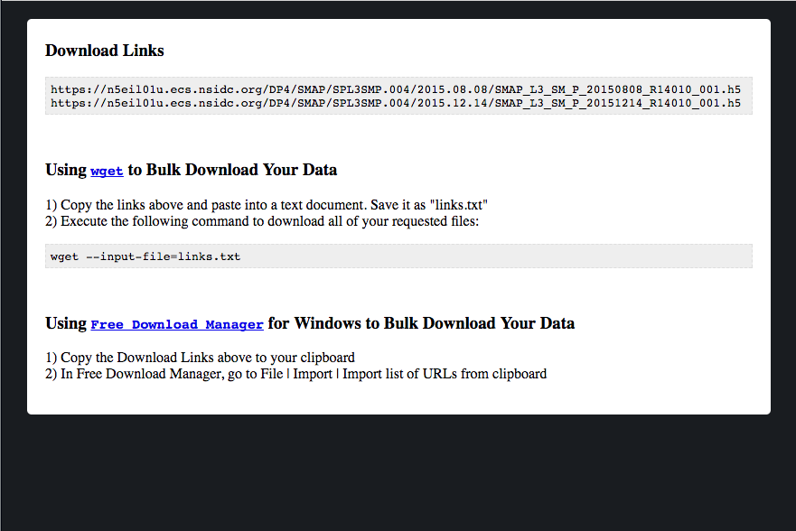
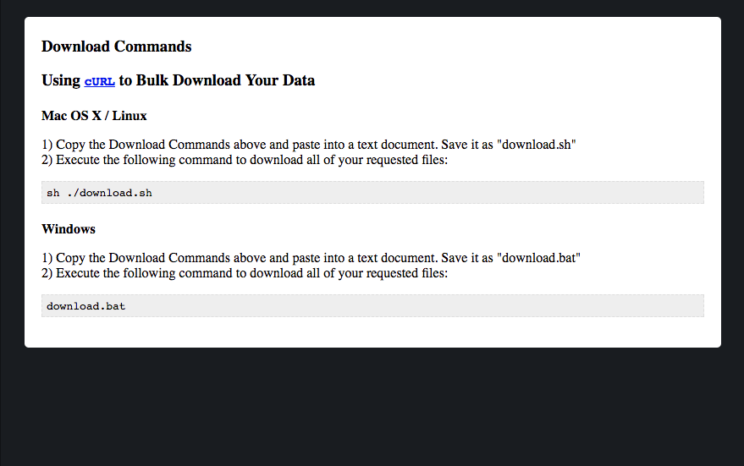
Downloading from Worldview

Slide 38
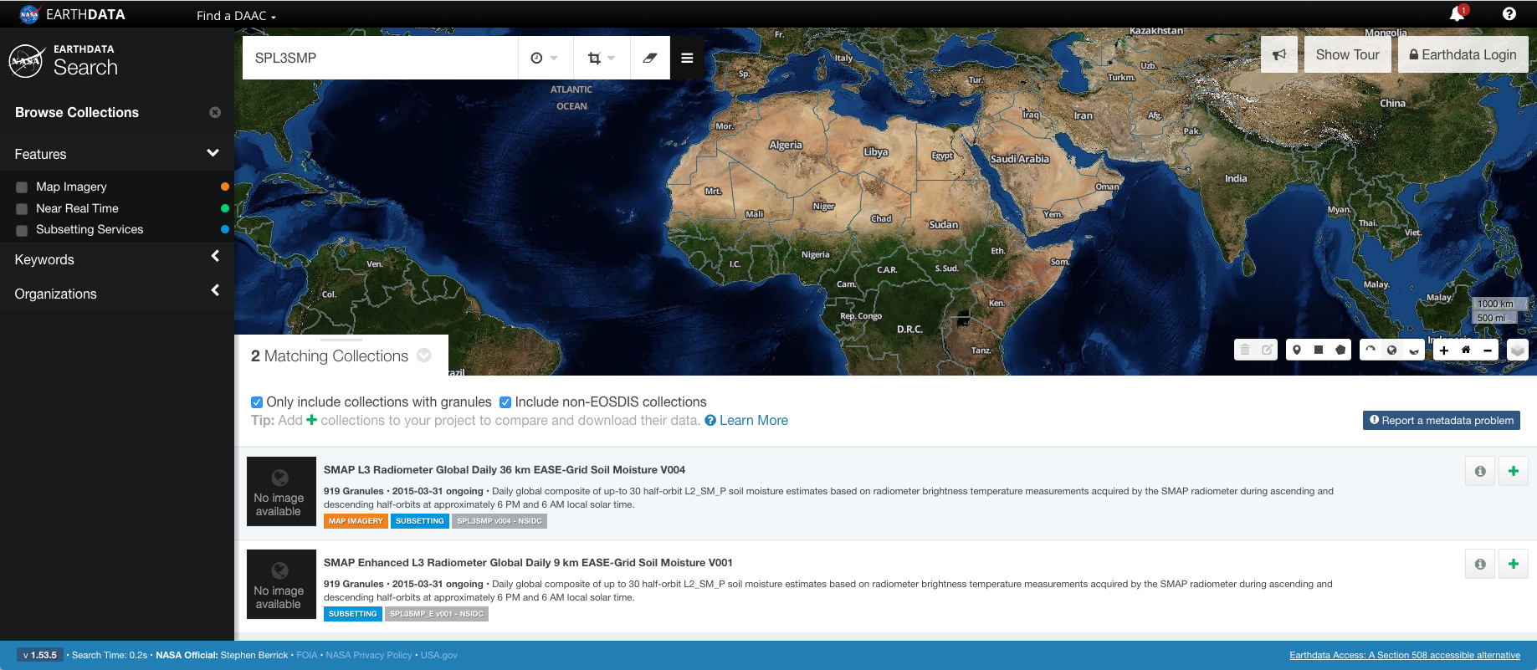
Search & Access SMAP Data from Earthdata Search
Click to login to Earthdata
Keyword search and filter options
Click to submit help request or feedback
Collections pane
Faceted filter pane
Add this collection to a project

Slide 39
Search & Access SMAP Data from Earthdata Search
South Polar Stereographic
Geographic (equirectangular)
North Polar Stereographic
Search by spatial coordinate
Search by spatial rectangle
Search by spatial polygon
Display the map’s base layer options

Slide 40
Search & Access SMAP Data from Earthdata Search
Display temporal & spatial filters once set
Erase selection or filters
Edit or delete spatial filter bounds
Crop data by polygon, point, rectangle, file, or grid coordinates

Slide 41
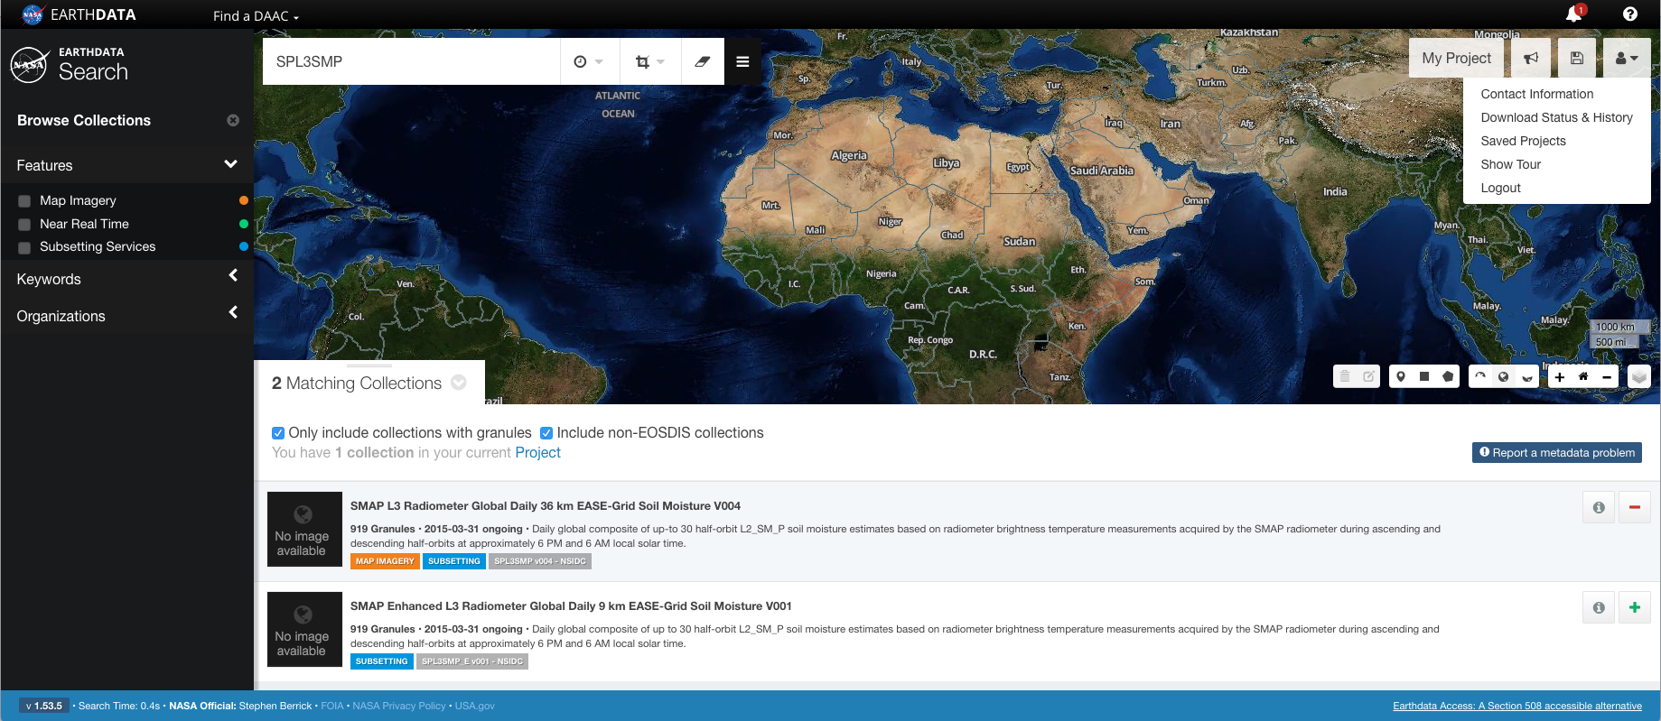
Search & Access SMAP Data from Earthdata Search
If you don’t already have an Earthdata Login, you will have to register for one before ordering data
Once you’ve logged in, you’ll see that the interface looks slightly different. You can now save projects, view other projects you’ve saved, and look through your order history
Click to save this setup as a project
Review contact information, recent orders, saved projects, or logout of your account
Clicking the – symbol will remove this collection from your dataset

Slide 42
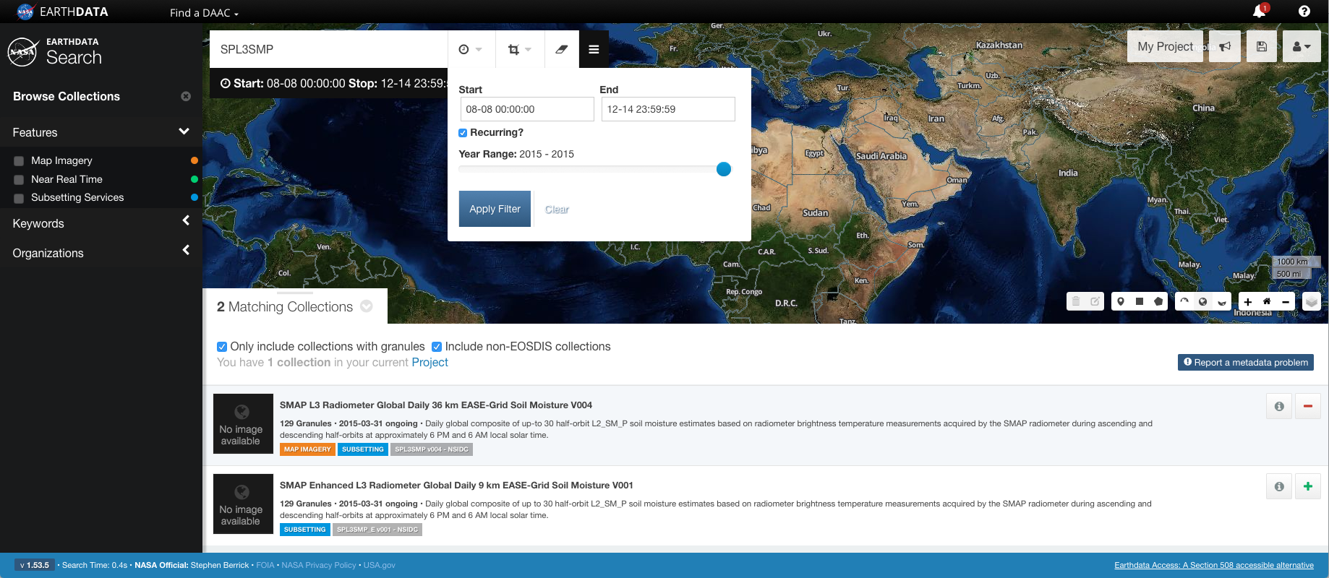
Set Temporal Search Filter
Login
Use the “Recurring?” option to limit the granules (files) returned to the dates between Aug 8 and Dec 14, 2015

Slide 43
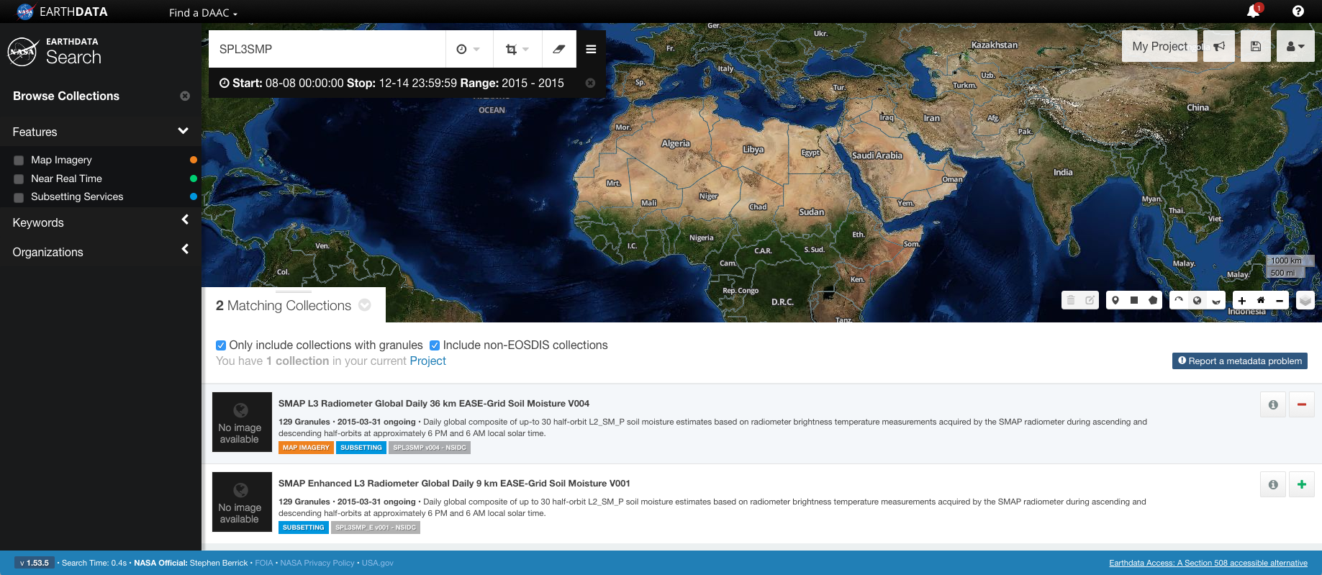
Set Temporal Search Filter
Notice the temporal search details display
Notice the granule count has dropped from 919 to 129 granules
Set the spatial search filter over Paraná, using the rectangle option

Slide 44
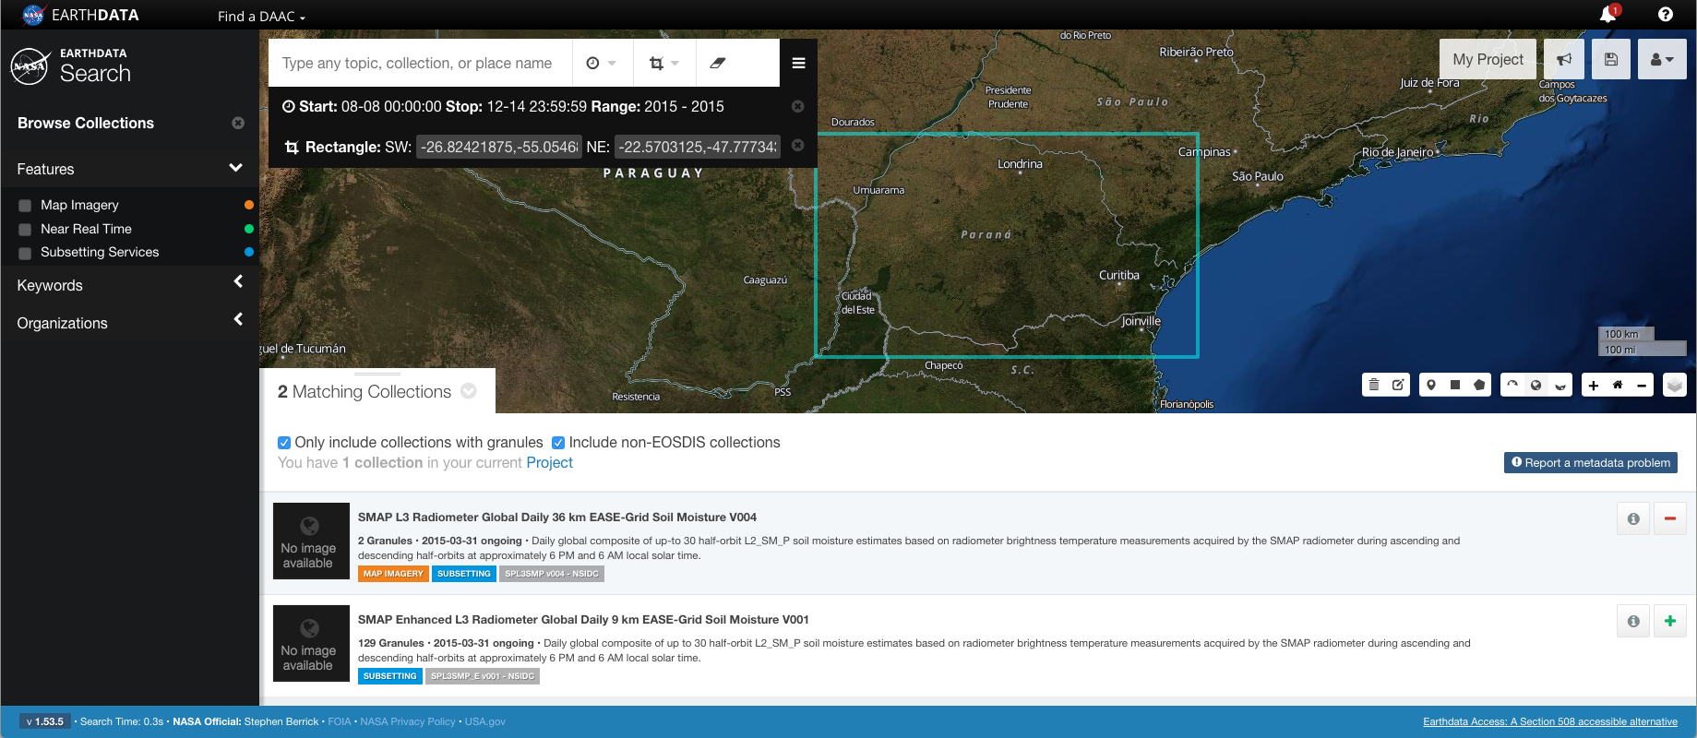
Set Spatial Search Filter
With the spatial search set, the coordinates are displayed along with the details of my temporal search criteria
Add the current project to your collection and view it. This is optional – you don’t have to use the project feature to order data

Slide 45
Set Spatial Search Filter
When you click on the text that says 8 Granules the pane changes to a new view displaying all 8 granules
Remove collection from the current project
View collection details

Slide 46
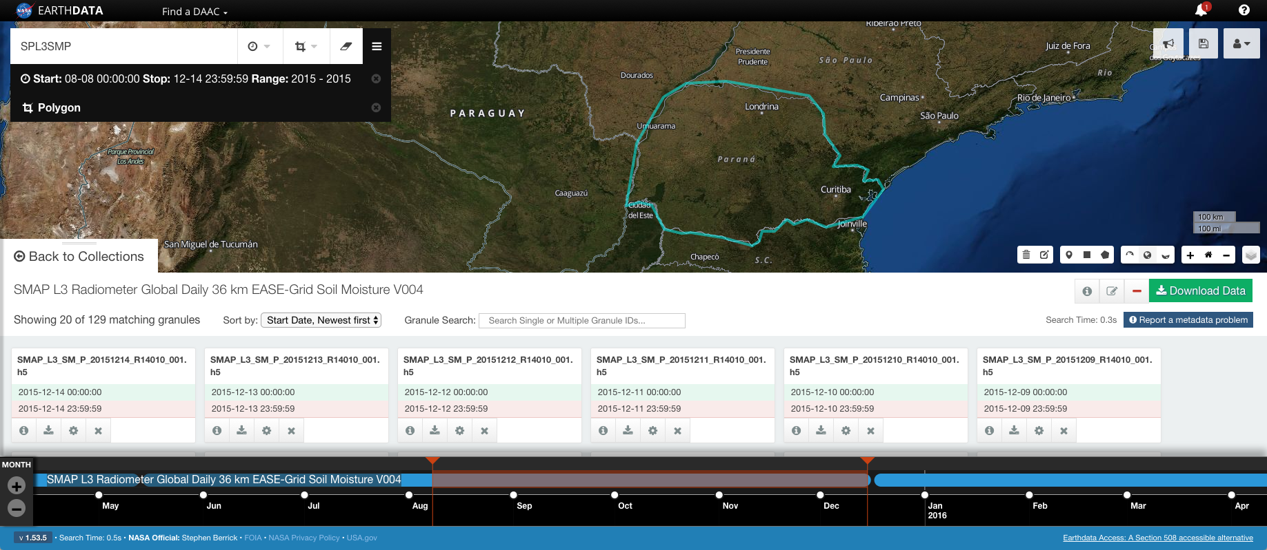
Granules Listed
Click the download icon to download individual files or the X symbol to delete a file from the list. Because there’s a large number of files we aren’t interested in, we could click on the two dates we’re interested in and do a direct download. For this example, we’ll delete all the granules we aren’t interested in
Notice that clicking on a granule name displays the extent of the file on the map
Download single granule data
View granule details
Remove granule
Configure and download single granule data

Slide 47
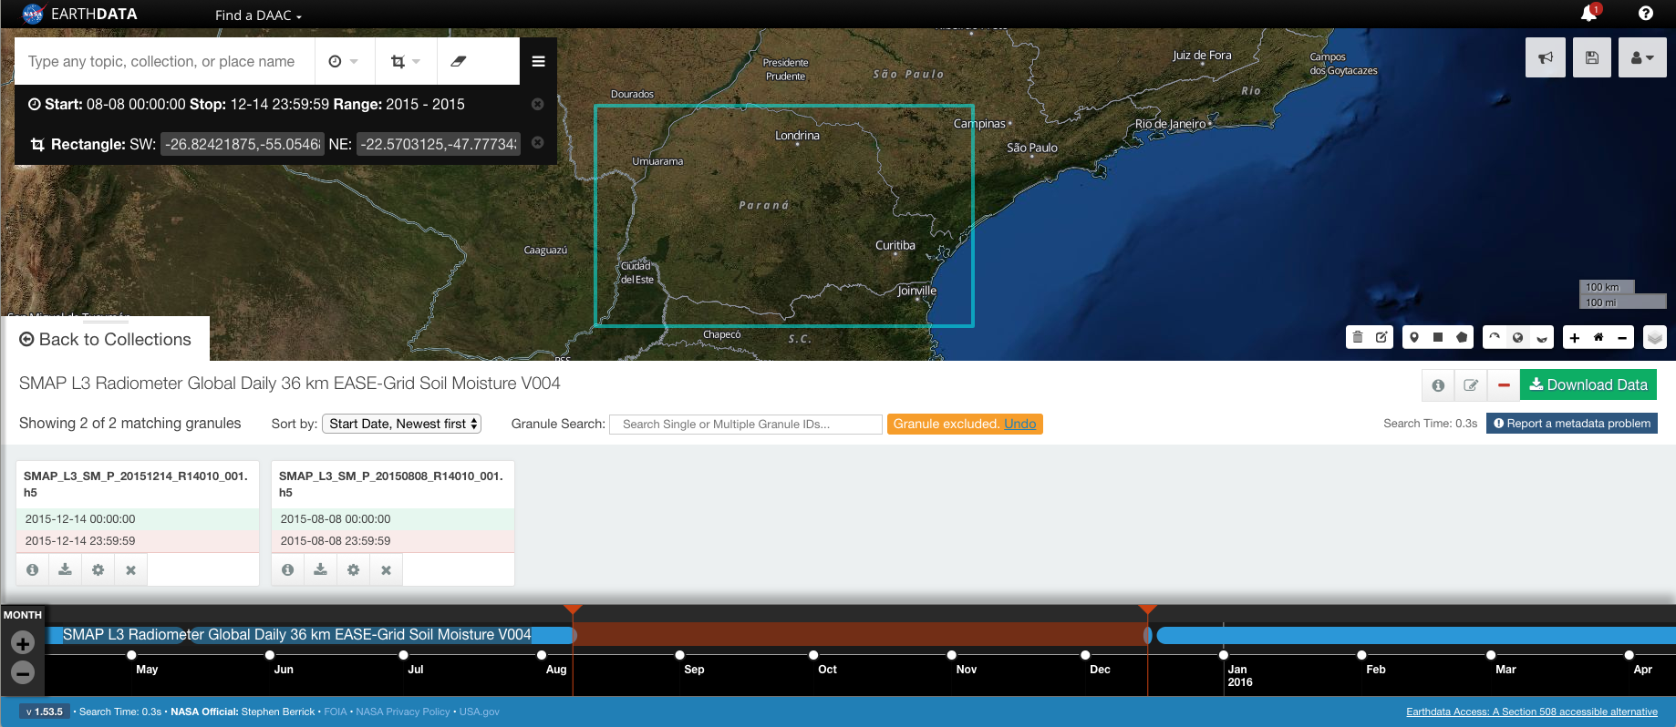
Granules Culled and Ready to Customize and Order
Click the download icon to download individual files

Slide 48
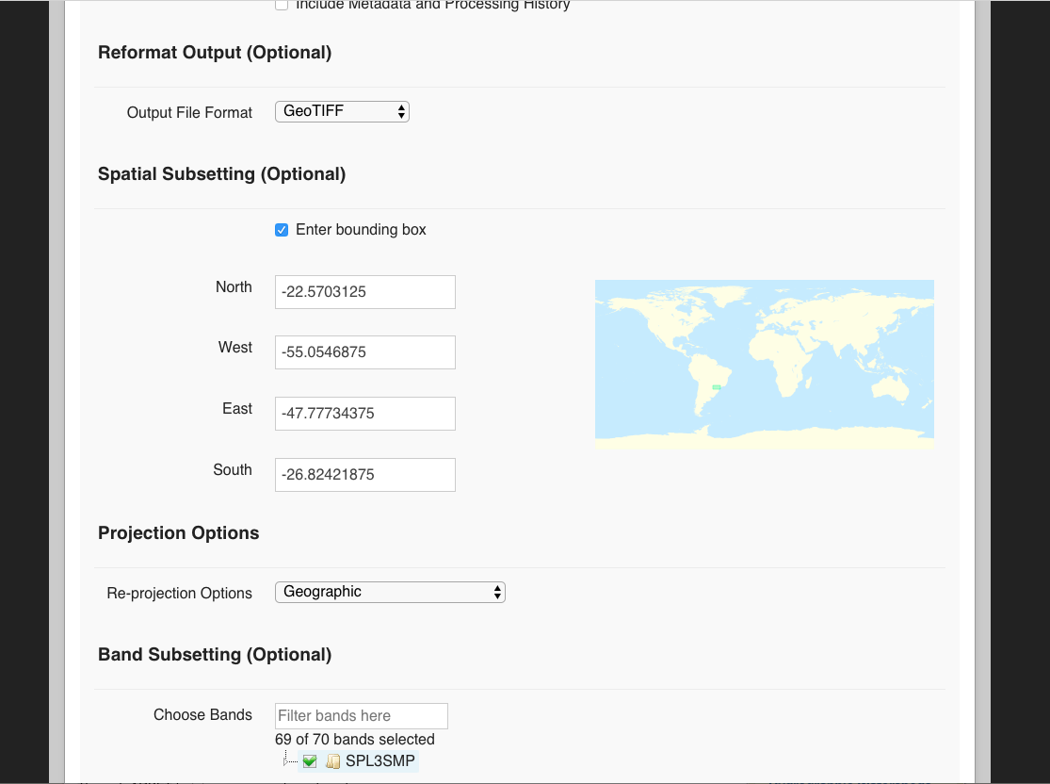
Customizing My Download
Select Customize Product
Set the Output file to GeoTIFF
The Spatial Subsetting will populate with the coordinates used in your spatial search criteria
Under Band Subsetting, click to deselect all options
Choose the parameters you want

Slide 49
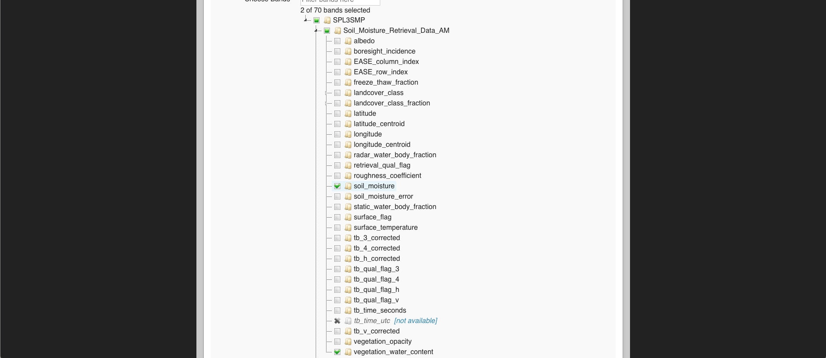
Customizing My Download
Choose the parameters you want

Slide 50
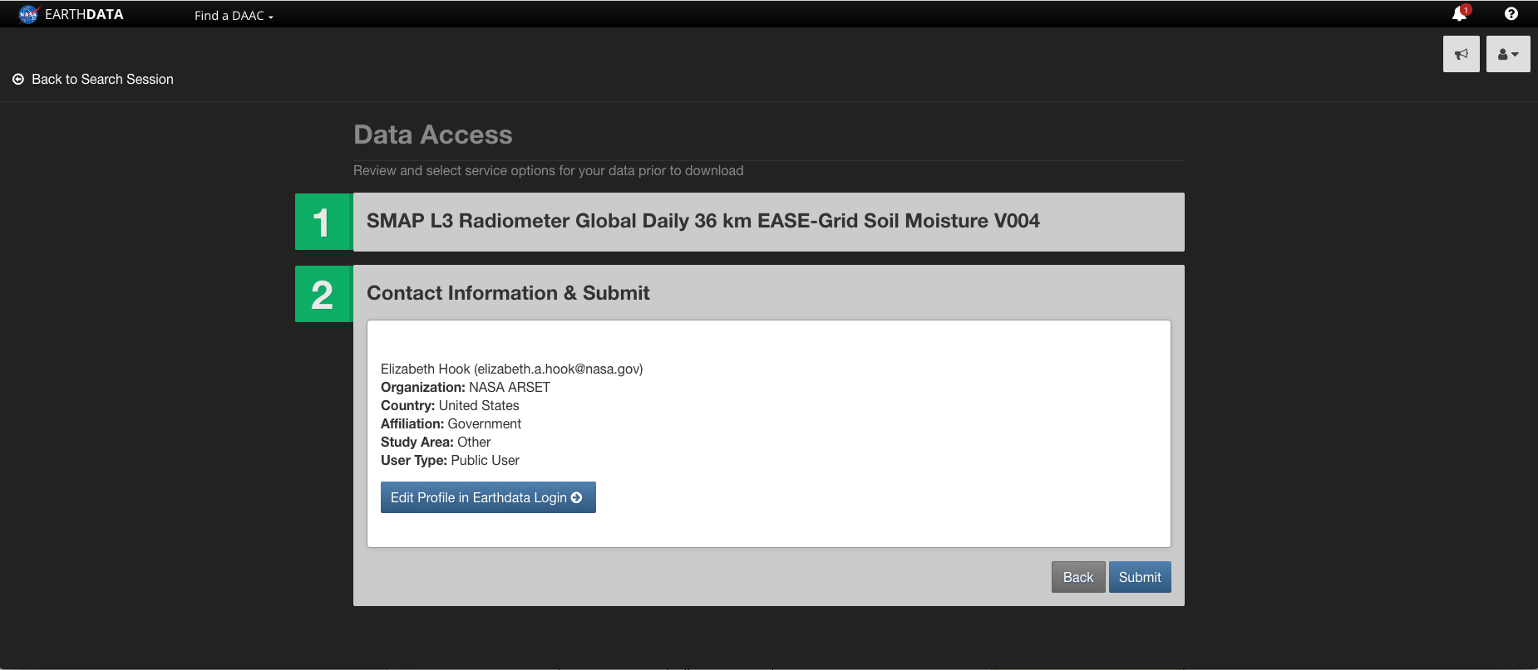
Submitting a SMAP Request

Slide 51
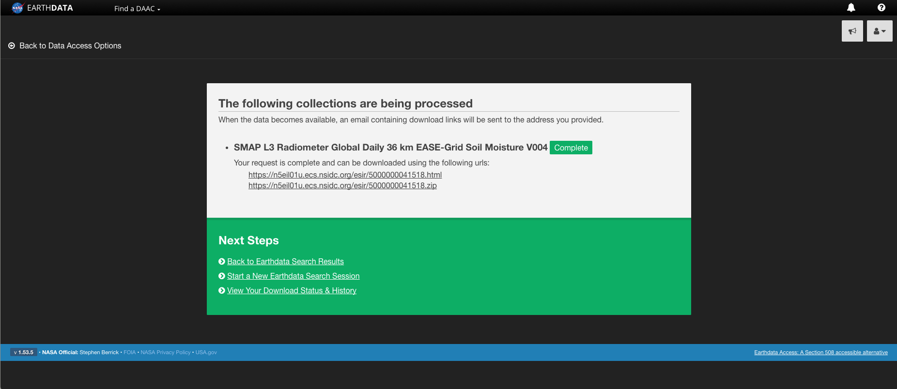
Retrieving a SMAP Output
You can click the html link to view request details or click the zip file to download everything at once
Request status – when complete, URLs are displayed

Slide 52
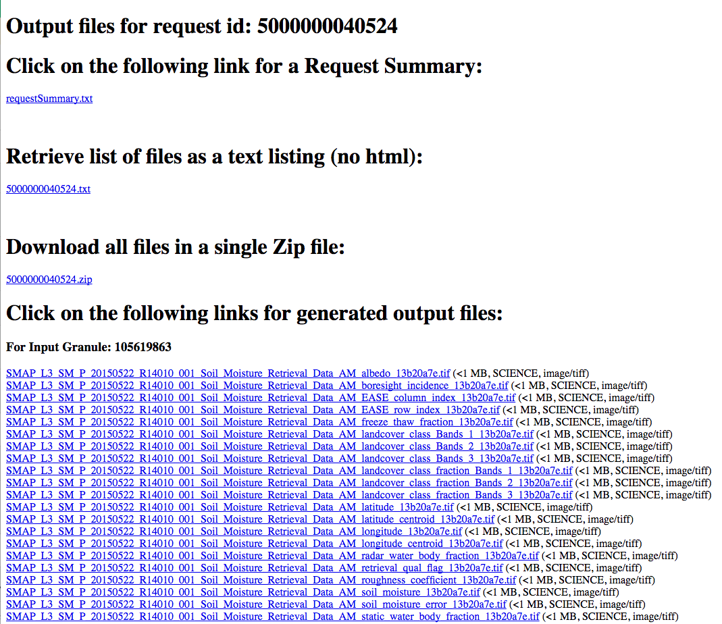
Retrieving my SMAP Output:
When you choose to reformat output to GeoTIFF, you will receive one tif per band selected for each granule in your request
Download the soil moisture tif images

Slide 53
SMAP Data Analysis

Slide 54
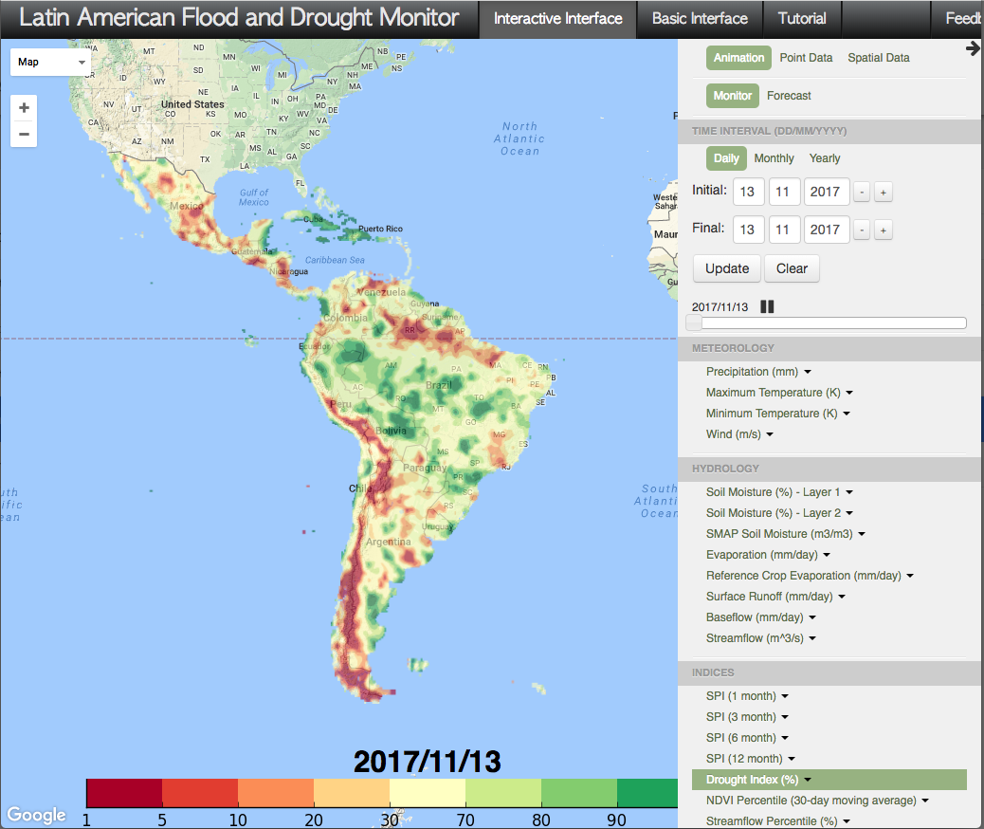
Extracting SMAP Soil Moisture
Go to the U.S. Flood and Drought Monitor tool from Princeton University:
http://stream.princeton.edu/LAFDM/WEBPAGE/interface.php?locale=en
This is the most direct way to extract SMAP soil moisture values

Slide 55
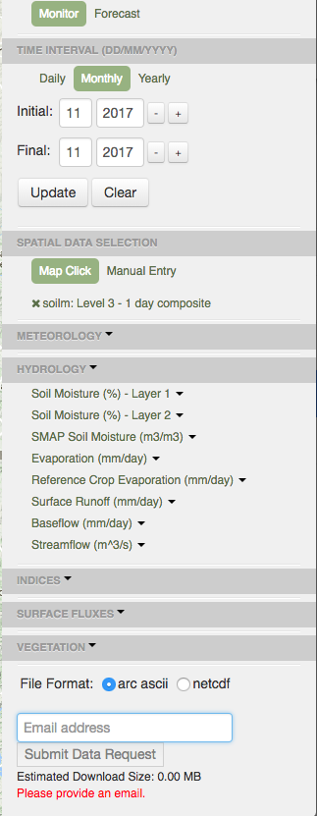
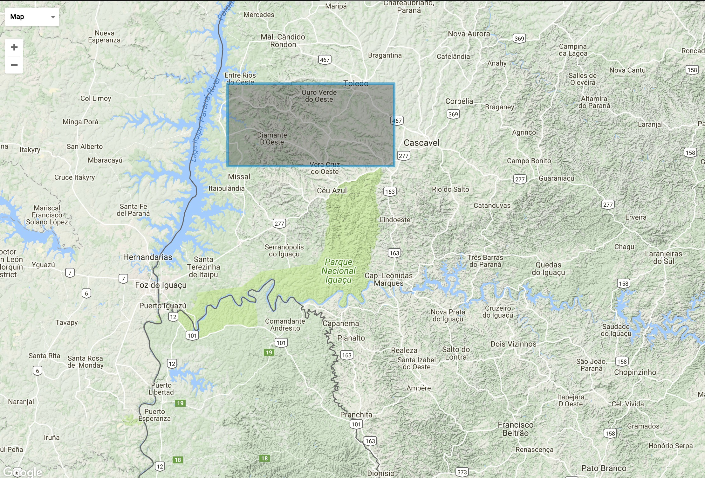
Specifying Parameters
In the upper-right window, select Spatial Data
Under Time Interval, select monthly. Specify Jan. 2016
Draw a box over the watershed
Under Hydrology, select SMAP soil moisture > Level 3-1day composite
For File Format, select arc ascii
Specify your email and click Submit Data Request

Slide 56
Opening the File
Open the text file with Excel
The results contain the average soil moisture for the month of Jan. 2016 for the pixels within the rectangle specified
Repeat the same extraction for Jan 2017, Feb 2016, and Feb 2017

